Slide 1
Chapter 22

Slide 2
Objectives

Slide 3
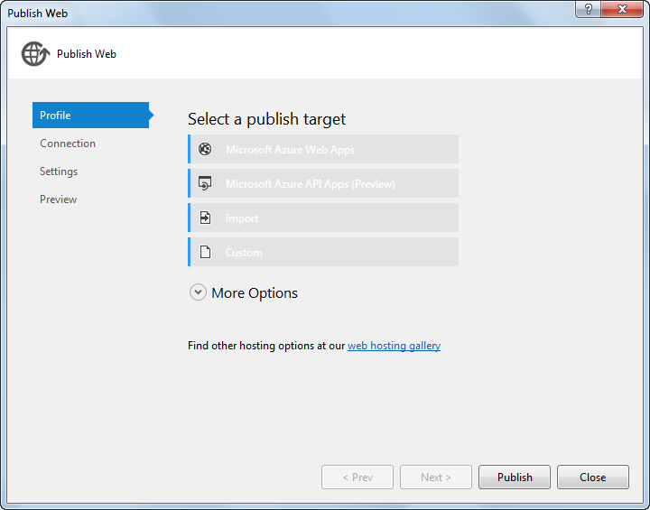
The Publish Web dialog box

Slide 4
Two ways to start the Publish Web wizard

Slide 5
The four methods for publishing to a selected target

Slide 6
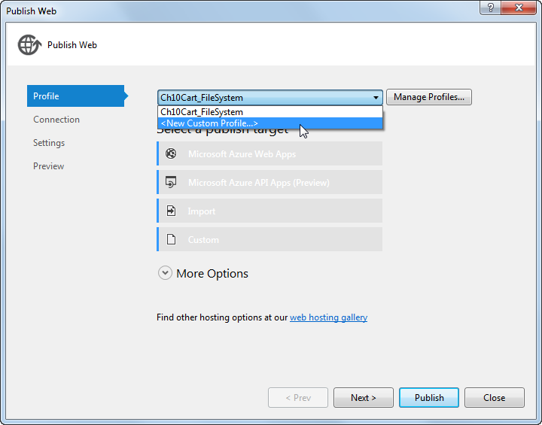
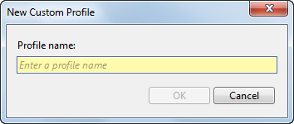
The Profile tab of the Publish Web dialog box

Slide 7
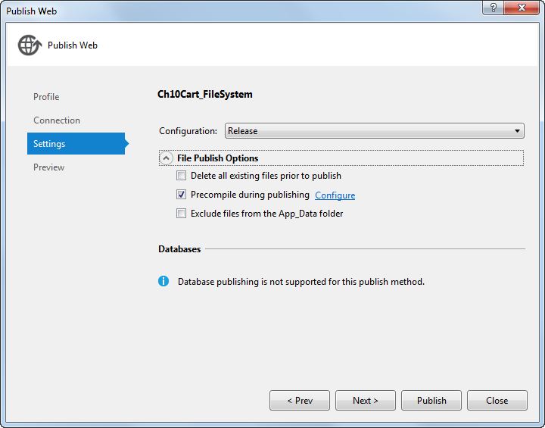
The file publish options in the Settings tab

Slide 8
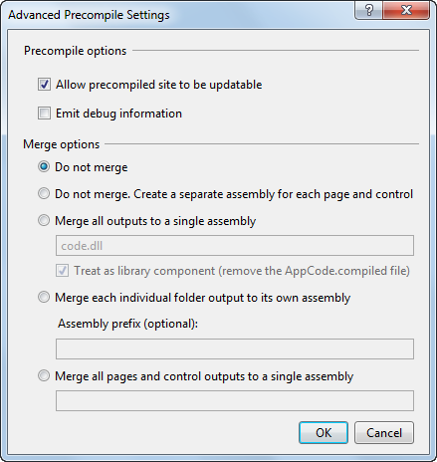
The Advanced Precompile Settings dialog box

Slide 9
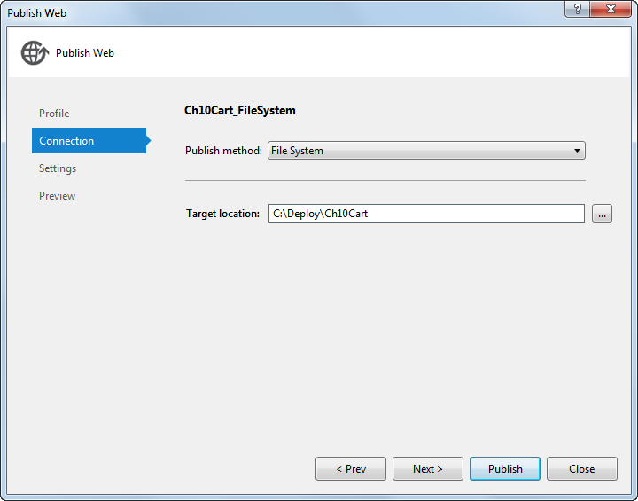
The Connection tab for the File System publish method

Slide 10
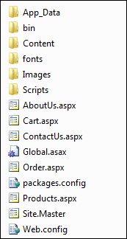
The published folders and files of the Shopping Cart application

Slide 11
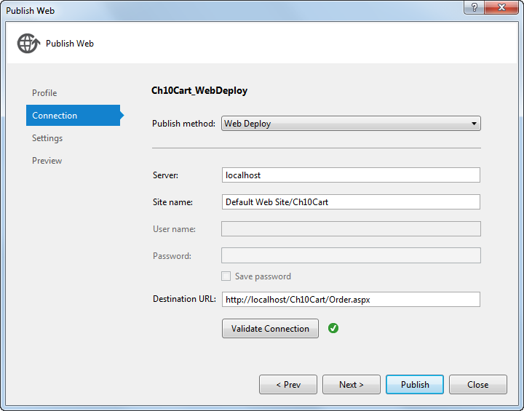
The Connection tab for the Web Deploy publish method

Slide 12
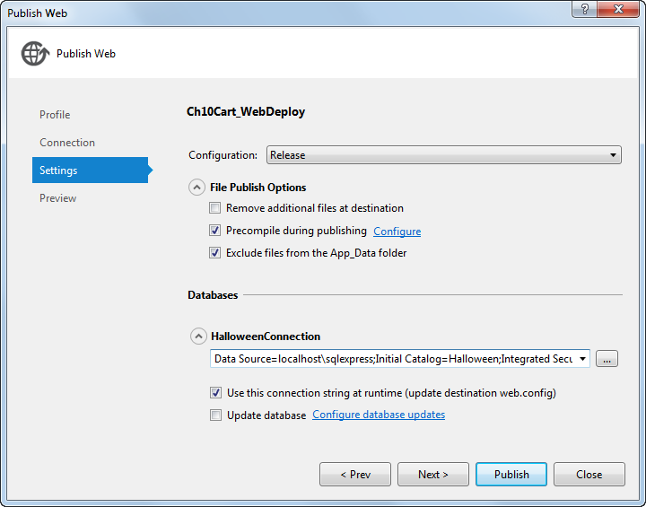
The database options in the Settings tab

Slide 13
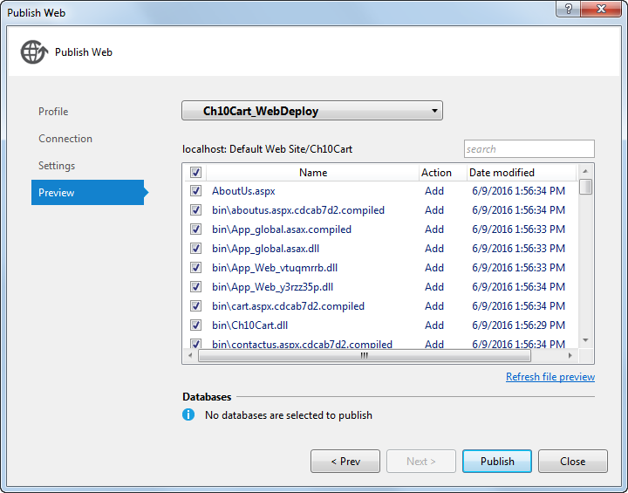
The Preview tab for the Web Deploy publish method

Slide 14
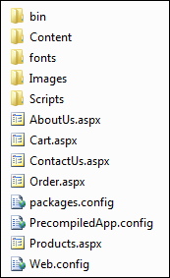
The published folders and files in the C:\inetpub\wwwroot\Ch10Cart directory

Slide 15

The content of the Cart.aspx file

